Slide 1
AGENDA
Review CLO use cases, applications, motivation for representing single cells
High level overview of common ground reached so far
Types of cultures, cells, processes to model and their relationships
The cell – culture – sample axis
Review definitions/labels for cells and cultures
Review consensus model tested in OBI
Home for classes representing cultured cells, cultures, samples, processes
Moving Ahead . . .

Slide 2
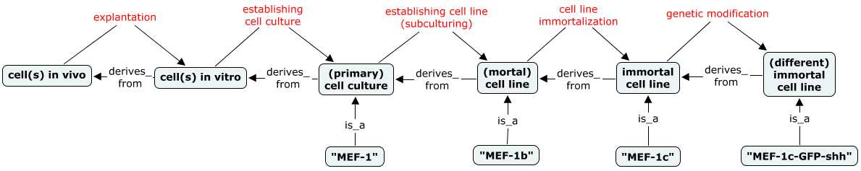

Consensus So Far . . .
Origination and chains of derivation are key for distinguishing fundamental concepts
a b c d e
‘cell culture’ refers to a collection of cultured cells deriving from single biological source that includes any passages of cells subsequent to its initial establishment (up to a point where the culture is modified in such a way as to establish a new cell culture or line)
‘primary cell culture’ refers to a cell culture established directly from a fresh tissue source, which has not been passaged to become a cell line
‘cell line’ refers to a lineage of cells that has been passaged into a more homogenous/stable line
there is only one instance of each culture/line above (MEF-1b, MEF-1c, MEF-1c-shh)
a new line is established at steps c, d, and e
Notes:
What things exist and how they are related. Origination and chains of derivation are essential for understanding and distinguishing these fundamental concepts, so I think a diagram like this is helpful.
Diagram shows inputs and outputs of processes from the explanation of a founder cell to the establishment and modification of immortal cell lines
Cell culture has two exhaustive, disjoint subtypes: primary cell culture, cell line
Below this are key points here to be sure we all agree on:

Slide 3
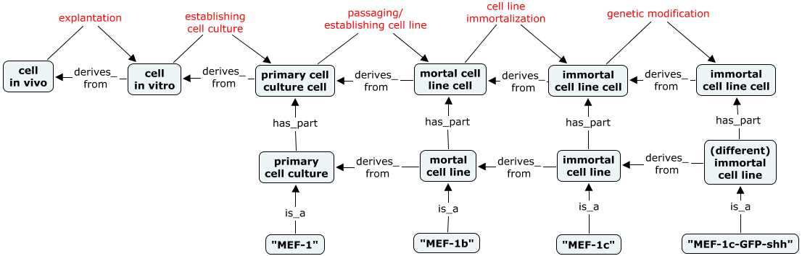
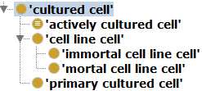
Consensus So Far . . .
Cells enter the picture as parts of cell cultures and lines.
Trivially, cells are inputs/outputs of the same processes as their collections.
a b c d e
A given cultured cell or cell line cell can be part of only one cell culture or cell line (because all cell cultures and lines have disjoint/mutually exclusive member cells)
For example, when a primary culture is passaged a new ‘cell line’ is created, and all cells output from this passage are no longer members of the old primary culture (which may continue to exist)
Even a single isolated cell line cell is necessarily part_of a cell line (since a cell line includes all cells derived from its establishment, independent of their being physically co-located )
Notes:
Below diagram are some key points to recognize and agree on.
primary cultured cells and cell line cells are necessarily cultured cells (to clarify, being cultured is different than having been passaged).

Slide 4
Review Class Definitions and Labels
https://docs.google.com/spreadsheet/ccc?key=0AiKzIoedGeqJdEkwd2Q1aFJPTHR5d0U5VUpkekJ3b1E#gid=0

Slide 5
Class Definitions: Challenges
https://docs.google.com/spreadsheet/ccc?key=0AiKzIoedGeqJdEkwd2Q1aFJPTHR5d0U5VUpkekJ3b1E#gid=0
1. Defining a ‘cell line’ has been particularly challenging (as evidenced by lively debate)
When is a new cell line established?
When does a primary culture become a cell line?
first passage? Xth passage? some non-passage criteria?
What experimental modifications of existing lines create a new line?
selection? immortalization? other genetic modifications?
Notes:
Do we want to be precise and specify that a single passage creates a line form a primary culture. Or be less precise to allow ambiguous definition of this transition, and/or application of different criteria in different situations?

Slide 6

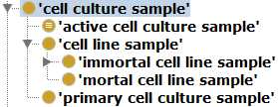
Review Consensus Model in OBI
Three hierarchies that represent different ‘populations’ of cells that are relevant in different contexts of experimental biology
1. A single ‘cultured cell’
review for implementation in CL or CLO (CLO requirements met?)
2. A ‘cell culture’ or ‘cell line’ as an entire lineage of cells
to live in OBI
3. A ‘cell culture sample’ as an applied portion of a cell culture/line
also to live in OBI
Notes:
- Accommodates all aspects of model discussed so far, and aims to meet needs of OBI, CLO, ERO, ReO, . . .
- OBI may not want to implement all of these classes (wary of duplication)
- But there are times when we want to talk about cultured cells at each of these levels, as there are characteristics and processes relevant to each.
gene expression (1)
morphology (1)
biological derivation (1 or 2)
growth characteristics (1 or 2)
genotype or STR profile (1 or 2)
establishment of a lineage (2)
experimental inputs (1 or 3)
passage number (3)
catalog offerings (3)
. . .

Slide 7
Review Consensus Model in OBI
Three hierarchies that represent different ‘populations’ of cells that are relevant in different contexts of experimental biology
OBI may not want to implement all of these classes (wary of duplication). But there are times when we want to talk about cultured cells at each of these levels, as there are characteristics and processes relevant to each.
gene expression (1)
morphology (1)
biological derivation (1 or 2)
growth characteristics (1 or 2)
genotype or STR profile (1 or 2)
establishment of a lineage (2)
experimental inputs (1 or 3)
passage number (3)
catalog offerings (3)
cell line contamination (3)

Slide 8

Cell Culture Samples (OBI)
Cell culture samples are collections of cells that represent a defined portion of a cell culture that has been continuously maintained together in culture (or has been removed from such a culture for storage or experimental application)
Definitional criteria clearly demarcate a useful collection of cells in a sample, which represents what researchers actually culture, experiment on, and share.
Will be a relatively uniform population (similar evolution/genetic drifts due to continuous co-culture)
All cells necessarily output from a single subculture or storage split . . .
and necessarily have the same passage number
Notes:
Meet CLO needs? . . . . ‘cell line cell population’?
Every cultured cell is part_of some cell culture
because a cultured cell does not exist until a culture is established
A cell culture sample necessarily has_part some cultured cell . . . but a cultured cell is not necessarily part of a cell culture sample
e.g. a single, isolated cultured cell is part of a cell culture, but not a cell culture sample
Other possible ways to demarcate what comprises a sample:
all cells of a line at a particular passage number? generation number? (will exist across different locations and times)
all cells of a line in a single lab?
all cells of a line in a single dish/container?
no demarcation rules at all (any conceivable portion of a given line)
other possibly useful ways for defining what constitutes a sample?

Slide 9


Cell Culture Related Processes (OBI)
Modeling of processes related to culturing cells and establishing / modifying cell lines
1. OBI:‘establishing cell line’ processes
OBI has an ‘establishing cell line’ class that should meet CLO needs for a ‘cell line generation/development’ class.
a process whereby a cell line is created through passaging of a primary cell culture to relative homogenous and stable composition, or through the experimental modification of an existing cell line to produce a new line with novel characteristics.
e.g. immortalization, genetic modification, selection of some defined subset
CLO:‘cell culturing’ hierarchy – to be aligned with OBI: ‘maintaining cell culture’
CLO:‘cell line modification’ classes – to be modeled in OBI as well
Notes:
estab cell culture definition uses ‘cell line’ – will this be problematic for CLO? CLO could relabel as ‘establishing cell line cell’ or ‘creation of cell line cell’, and could define instead as:
“a process whereby a lineage of cell line cells is initiated through passaging of a primary cell culture to relative homogenous and stable composition, or through the experimental modification of an existing cell line to produce a new line with novel characteristics.

Slide 10
‘Active’ Culture Classes for CLO
Are ‘actively cultured cell’/’active cell culture’ defined classes sufficient for what CLO needs?
‘actively cultured cell’ = a cultured cell that is actively being propagated or maintained in culture medium
’active cell culture sample’ = a cell culture sample that is actively being maintained or propagated in vitro
(does not include media)
Does CLO need a class representing cells plus media?

Slide 11
Recap and Moving Forward
Does ‘cultured cell’ model meet CLO requirements?
Implement in CLO (or CL?) and OBI will MIREOT back
Does ‘cell culture’ and ‘cell culture sample’ modeling work for all?
Will live in OBI and CLO can import what it needs.
How fit with Oliver’s ‘cell line cell population’
Utility of ‘cell culture/line’ representation in addition to samples?
Are ‘actively cultured cell’/’active cell culture’ classes good for CLO?
Need for a class representing cells plus media?
Are cultured cells ‘experimentally modified’?
Punt for now and assert as types of CL:’cell in vitro’
Culturing processes also to live in OBI and be imported by CLO
more work needed here
Notes:
Label may depend on how we define this class (or classes)
cell line sample, portion
cell line cell population (Oliver)
Do we need a class representing a culture including media? Will likely leave this to CLO to implement if they need it (OBI no want a possible fourth duplication of cell line hierarchy)
we can link actively cultured cells to media and culture conditions through the maintaining cell culture process (ie actively cultured cells participate in some maintaining cell culture that has specified input some media type, or realizes some conditional specifications (O2 concentration,. temperature)

Slide 13
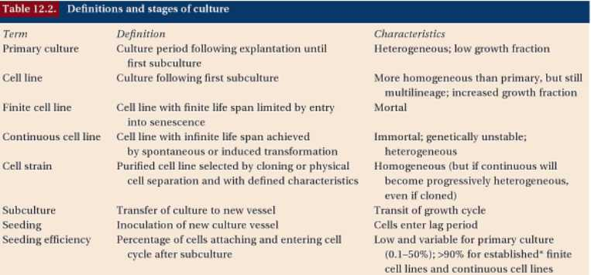
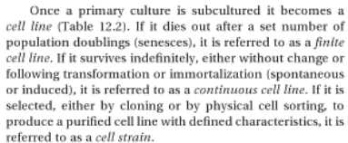
Principles of Tissue Engineering (Third Edition) 2007 Edited by Robert Lanza, Robert Langer and Joseph Vacanti, Elsevier Inc., ISBN: 978-0-12-370615-7 <http://www.sciencedirect.com/science/book/9780123706157>
Notes:
cant rely on forums and non-authoritative definitions – these are varied and ambiguous and only highlight the problem that terms such as cell line are inconsistently used and understood. Need to rely on experts and authoritative sources such as cell culture methods books

Slide 14
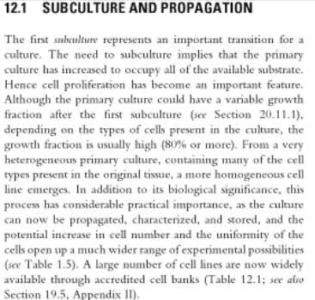
Culture of Animal Cells: A Manual of Basic Technique and Specialized Applications, 6th Edition', R. Ian Freshney, 2011, Wiley-Blackwell, ISBN: 978-0-470-64935-0 http://www.wiley.com/WileyCDA/WileyTitle/productCd-0470649356.html
Notes:
Another methods book supporting this view: http://books.google.com/books?id=3GHwAAAAMAAJ&q=%22cell+line%22#search_anchor

Slide 15
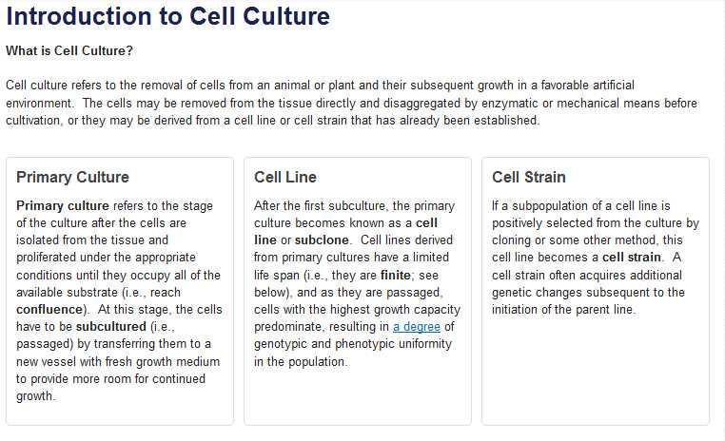
Invitrogen Cell Culture Handbook: http://www.invitrogen.com/site/us/en/home/References/gibco-cell-culture-basics/introduction-to-cell-culture.html
Notes:
http://www.invitrogen.com/site/us/en/home/References/gibco-cell-culture-basics/introduction-to-cell-culture.html

